Slide 1


This section is elaborated by :
Houssem Ben Brahim
currently a student in : Enetcom
PHD
93221240
benibrahimehoussem@gmail.com

Slide 2


Arduino history
The name Arduino comes from a bar in Ivrea, Italy, where some of the founders of the project used to meet.

Slide 3
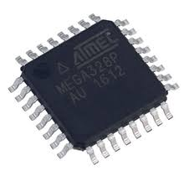
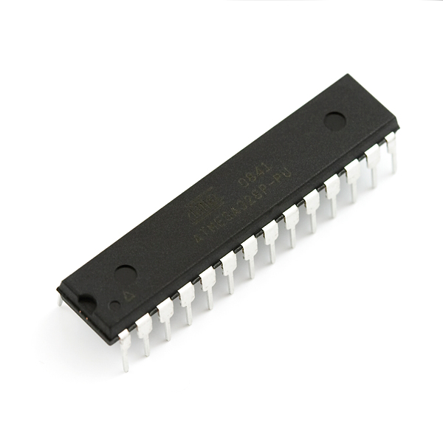
Arduino is an µC
Arduino basically contains a micro controller; Programmable integrated circuit.
Input/Output pins
µC
Input/Output pins

Slide 4
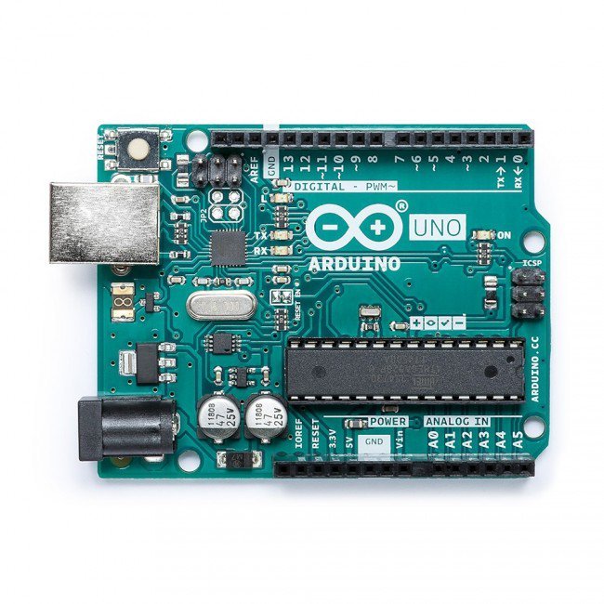
Arduino example board
I/O
USB
USB/UART
converter
µC
Power supply
I/O
Power

Slide 5
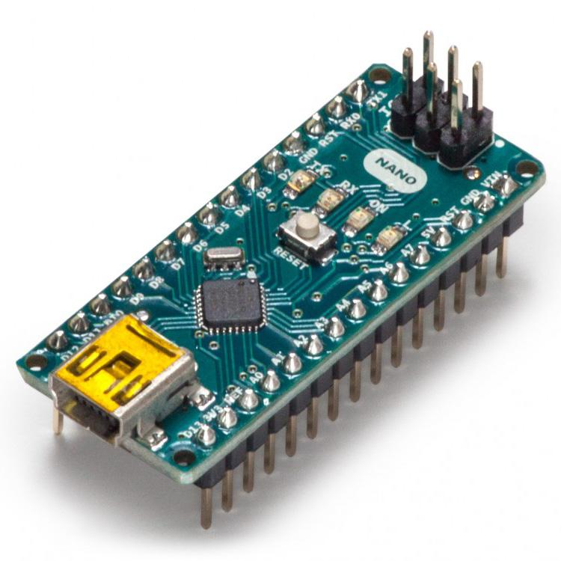
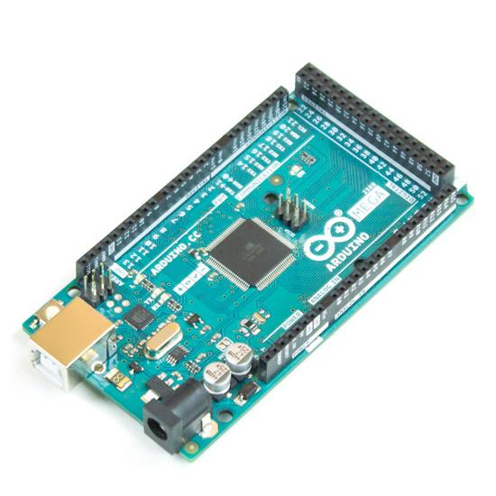
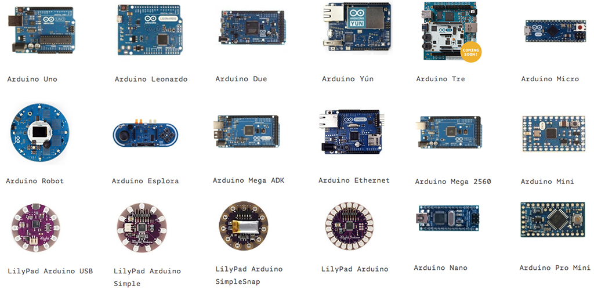
Arduino example board

Slide 6
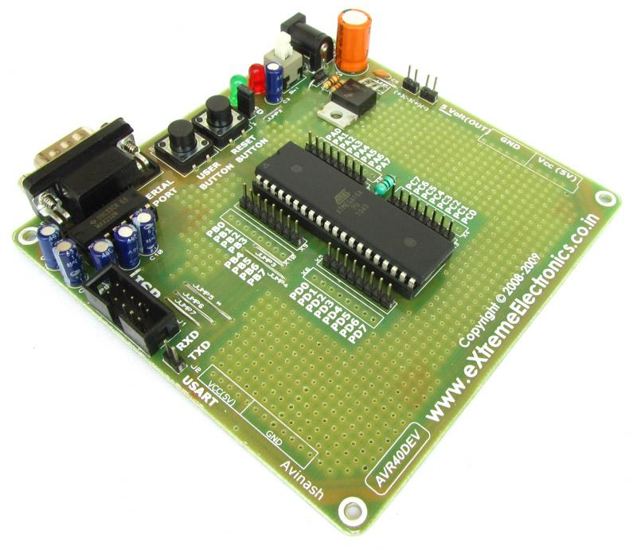
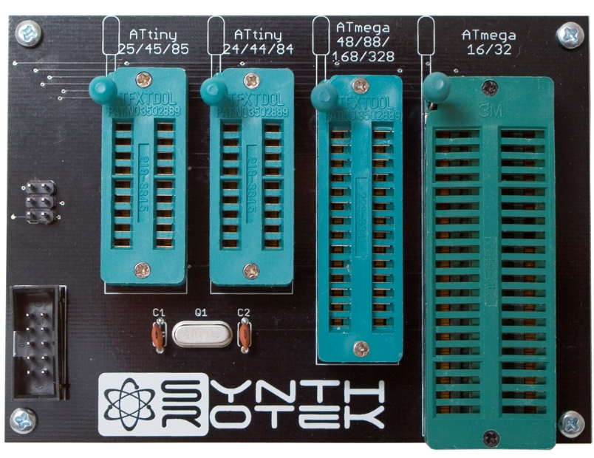
Why we use Arduino?
µC programmator
Before arduino is founded, to program a µC we must:

Slide 7
Arduino IDE
The open-source Arduino Software (IDE) makes it easy to write code and upload it to the board. This software can be used with any Arduino board.
Arduino code is written in C++
an addition of special methods and
functions
(C++ is a human-readable programming language)

Slide 8
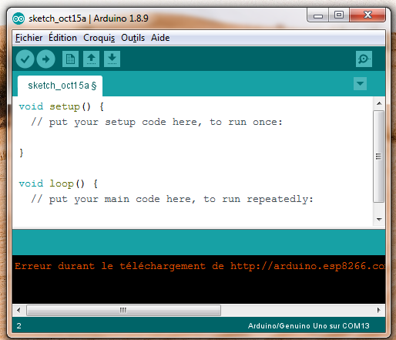
Let’s make our first Arduino program
Void Setup()
Void Loop()

Slide 9
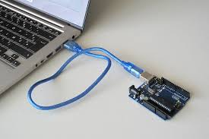
Connect arduino with your pc

Slide 10
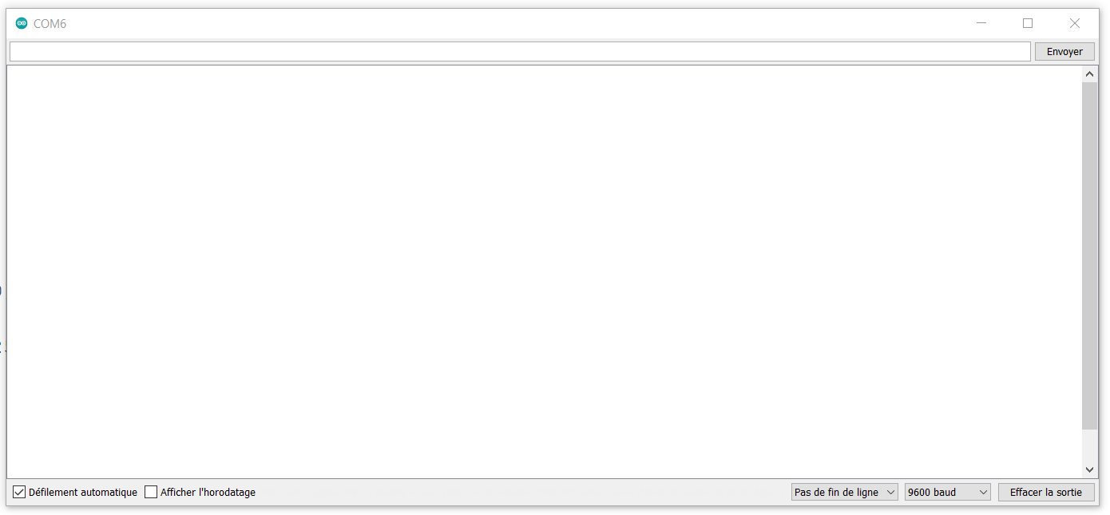
Serial monitor
The Serial Monitor is a separate window that acts as a separate terminal that communicates by receiving and sending Serial Data from Arduino to pc or from pc to Arduino .

Slide 11
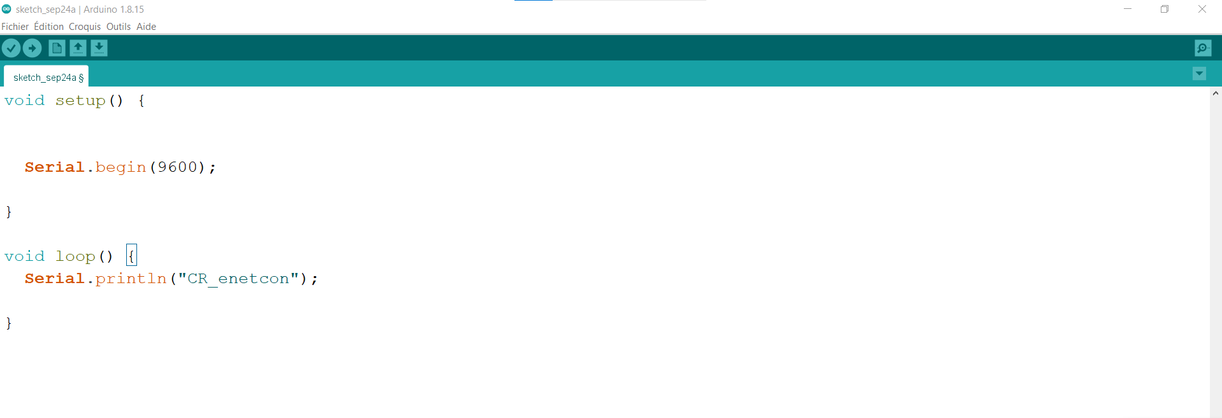
To use Serial Monitor we must:
Start Serial communication
Configure baud rate (bit/s)
Write message to print
1
1
2
3
2
3

Slide 12
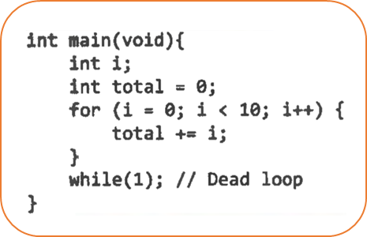
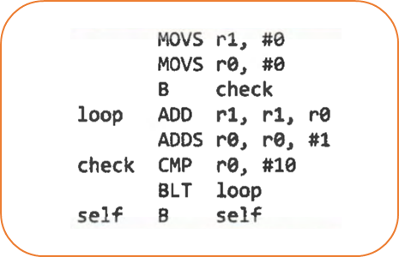
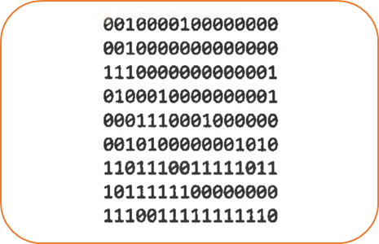
Compiler
Compiler
Assembler
µC

Slide 13
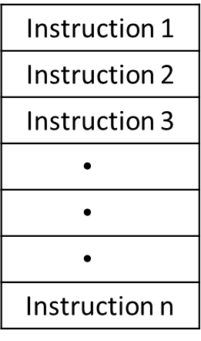

Compiler
µC
Memory
CPU
peripheral
Motors
LED
Sensors
Bluetooth …

Slide 14
Arduino is an µC
The micro controller’s pin may have two states:
5v
0V
Logical 0: LOW
Logical 1: HIGH

Slide 15
Arduino OUTPUT
The micro controller’s pin may have two Output states:
µC
Vcc
µC
OUTPUT: 0
OUTPUT: 1
Output peripheral
T=5v
T=0v
GND
GND

Slide 16
Arduino INPUT
The micro controller’s pin may have two Input states:
µC
VCC
Vcc
µC
+
-
INTPUT: 1
INTPUT: 0
Vref
3V
Input peripheral
T=5v
T=0v
GND

Slide 17
Abstract
If the µC Input switch = 0 then the Output LED <= 0
If the µC Input switch = 1 then the Output LED <= 1
VCC
µC
INTPUT: 1
INTPUT: 0
OUTPUT: 1
OUTPUT: 0
T=0v
T=5v
T=5v
T=0v
GND
GND

Slide 18

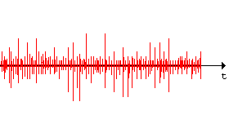

Arduino Input
Problem 1
VCC
Antenna
µC
INTPUT: 0
INTPUT: 1
T=0v
10K.
T=5v
GND
This resistor named : pull down resistor
The Input can be equal to 1 !
So we must eliminate this signal noise

Slide 19
Arduino Input
Problem 1
If We have pull down resistor so can we found pull up resistor ?

Slide 20
Arduino Input
Problem 1
µC
VCC
Input/Output
peripheral
10K
INTPUT: 0
INTPUT: 1
GND

Slide 21
Arduino Input
Problem 1
µC
VCC
🡪 Arduino pin Mode can be : -INPUT
🡪 Arduino pin Mode can be : -INPUT
-INPUT_PULLUP
10K
Input/Output
peripheral

Slide 22
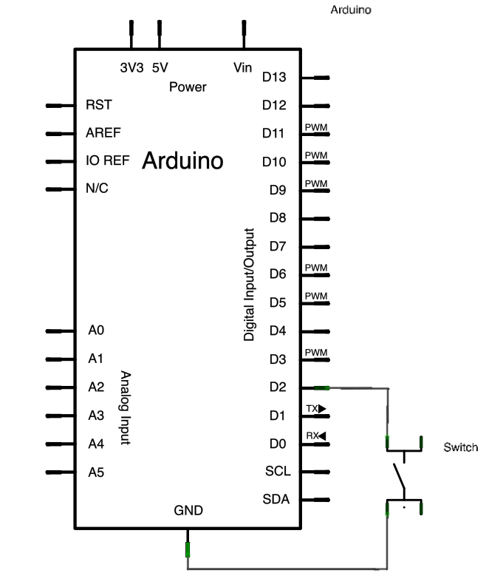
Exercice
If a switch (attached to pin 2) is pressed LED turn on
Else LED 13 turn off

Slide 23
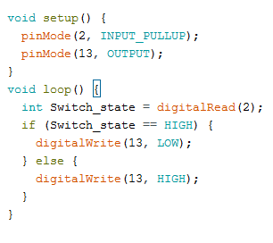
Solution

Slide 24
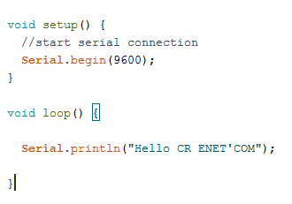
Serial monitor
Exemple 1

Slide 25
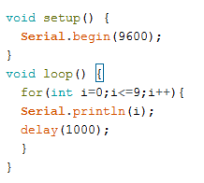
Exercice
Make a program that print a number from 0 to 9 each second:

Slide 26
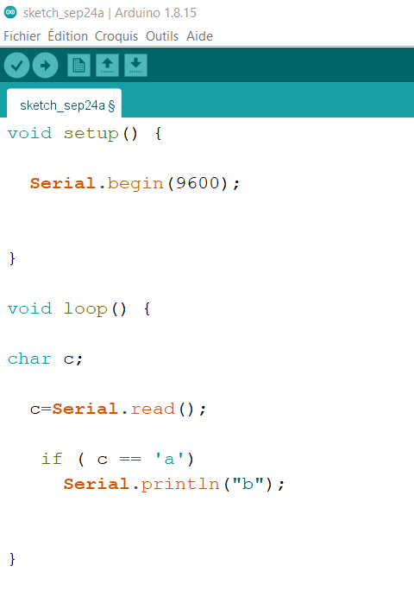
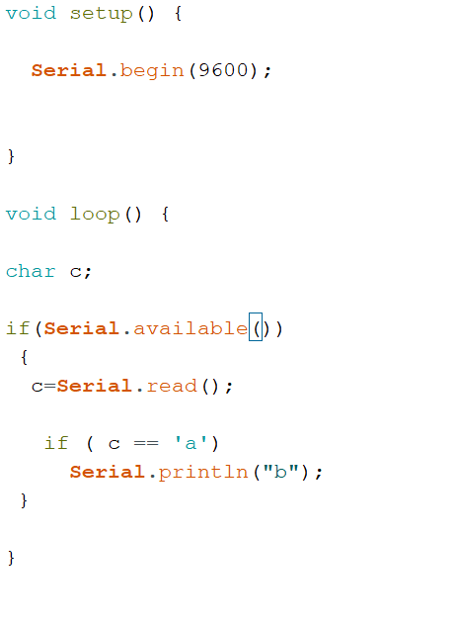
Exemple
Make a program to receive a caracter ‘a’ and send a caracter ‘b’.

Slide 27
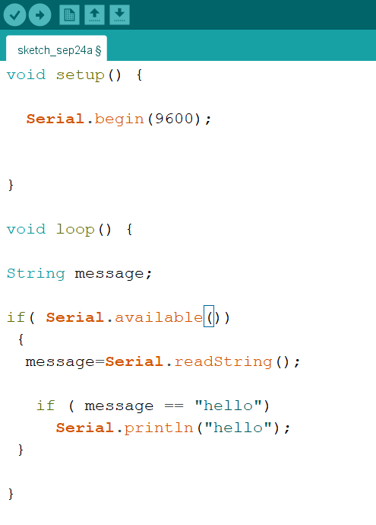
Exercice
Make a program to receive a message “hello” and send a “hello”.

Slide 28
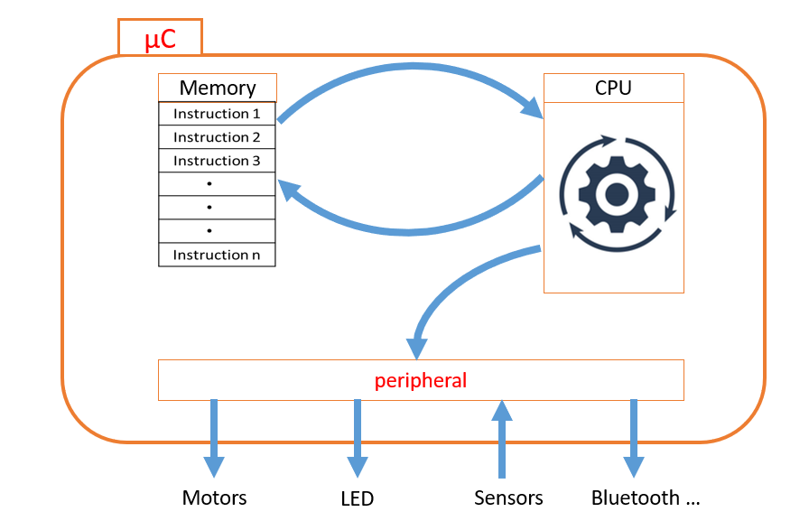
Analog Input
The Arduino can input analog signals as well as digital signals.
To measure the value of analog signals, the Arduino has a built-in analog-to-digital converter (ADC). The ADC turns the analog voltage into a digital value. The function that you use to obtain the value of an analog signal is analogRead(pin).
Arduino analog Input
5V
0V
ADC
1023
0

Slide 29
Analog Input
analogRead()

Slide 30
Analog Input example
Alimentation
Arduino
0°c 🡪50°c
Temperature sensor
0V 🡪5V
0🡪1023
What’s the value of the Arduino input when the temperature is 25°C?

Slide 31
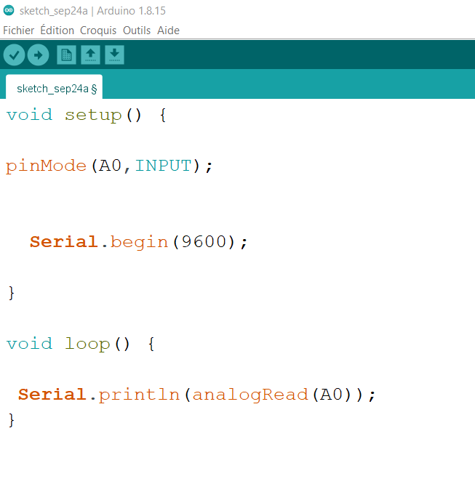
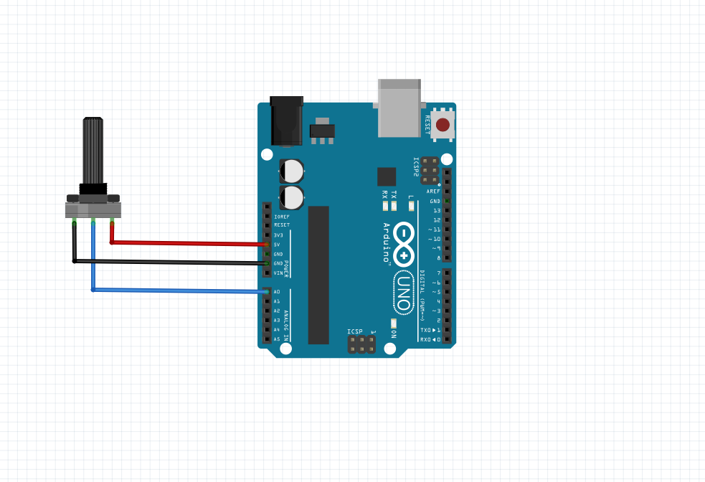
Analog Input example
Print in Arduino serial monitor the value of Potentiometer

Slide 32
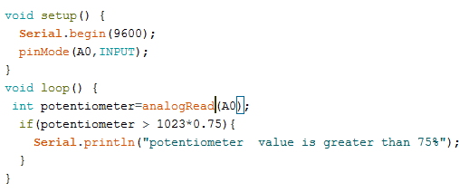
Exercice
Make a program that print an alert when potentiometer value greater than 75%

Slide 33
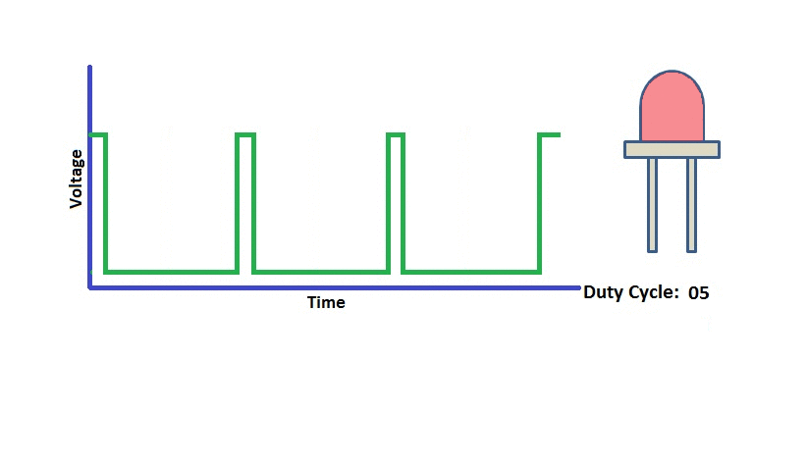
PWM Output
Arduino
GND
Voltage
Tmoy=Tmax=5V
Tmoy<5V
With Arduino we can generate this signal that called PWM(pulse width modulation)
t

Slide 34
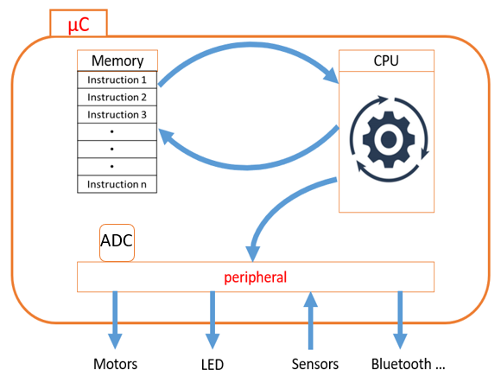
PWM Output
Arduino analog output
255
0
PWM
5 V
0 V

Slide 35
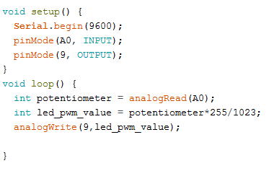
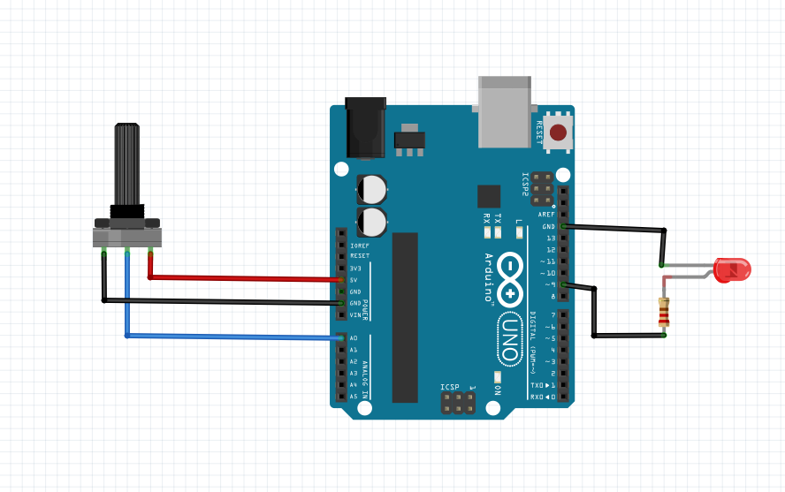
PWM exercice
led brightness control using potentiometer

Slide 36
PWM example with map function
Re-maps a number from one range to another. That is, a value of fromLow would get mapped to toLow, a value of fromHigh to toHigh, values in-between to values in-between, etc.
Example :
y = map(x, 0, 1023, 0, 255);
map(value, fromLow, fromHigh, toLow, toHigh)
X: 0 1023
y: 0 255

Slide 37
Exercice
In this example, we will send the commands from serial monitor to arduino to:
turn on/off a led (‘’on’’: turn on led / ‘’off’’: turn off a led)
- Read and send the value in the potentiomtre

Slide 38
A0 14
A1 15
A2 16
A3 17
A4 18
A5 19
analogWrite()
digitalRead()
digitalWrite()
digitalRead()
digitalWrite()
analogRead()

Slide 39
Arduino Communication Protocols: UART, I2C, SPI
What are Communication Protocols?
A set of rules that allows two or more electronic devices to exchange data.
Defines the language, speed, error checking, and physical connections.
Why Do They Matter?
Microcontrollers like Arduino are the "brains" of a project.
Protocols are the "nervous system" that lets the brain talk to sensors, displays, and other modules.
Essential for building complex systems in Robotics, IoT, and Embedded Systems.
Common Arduino protocols:
UART (Serial)
I2C (Two‑Wire)
SPI (High‑Speed Synchronous)

Slide 40
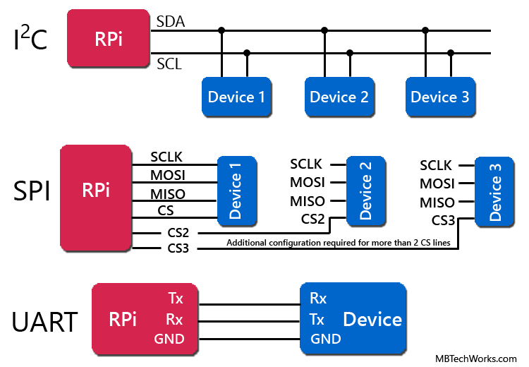
Arduino Communication Protocols: UART, I2C, SPI

Slide 41
Arduino Communication Protocols: UART
Definition: Universal Asynchronous Receiver/Transmitter (UART) is a simple, two-wire, asynchronous serial communication protocol.
Key Concepts:
Asynchronous: No shared clock signal. Devices must agree on a speed beforehand.
TX (Transmit) & RX (Receive): Data lines are crossed between devices.
Baud Rate: The speed of communication (e.g., 9600, 115200 bits per second). Mismatched baud rates cause garbage data.
Advantages:
Simple, widely supported, only two wires for data.
Limitations:
Point-to-point only (one device to one device), relatively slow, short distance.

Slide 42
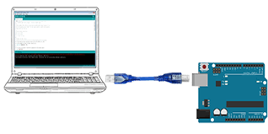
UART Code Example (Arduino to PC)
Controlling Arduino from Serial Monitor
Scenario: Send commands '1' or '0' from the PC Serial Monitor to control an LED on the Arduino.
Arduino USB Port → Computer USB Port
LED connected to Pin 13 with current-limiting resistor

Slide 43
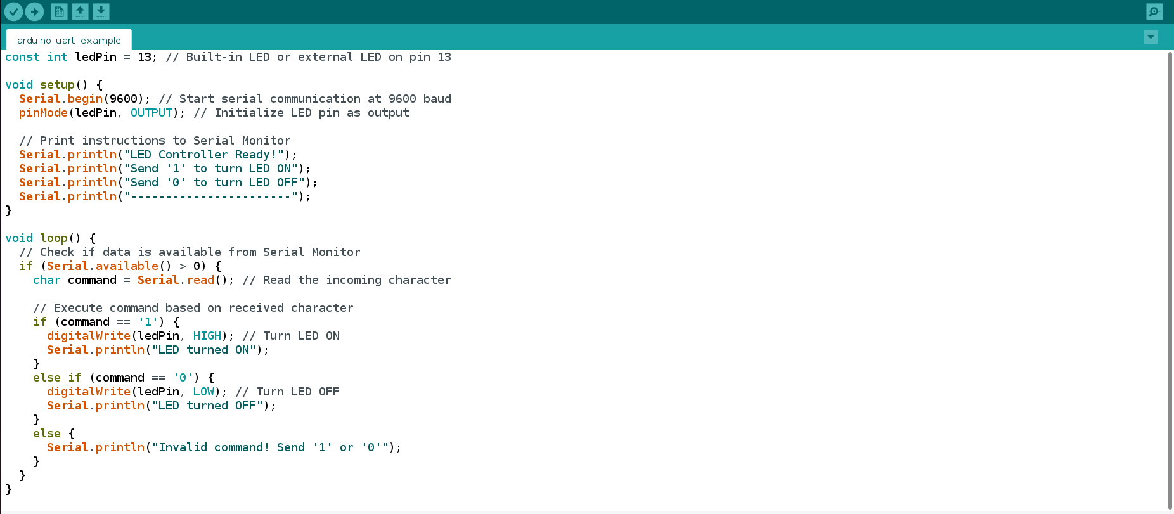
UART Code Example (Arduino to PC)
Arduino Code (Receiver & Controller)

Slide 44
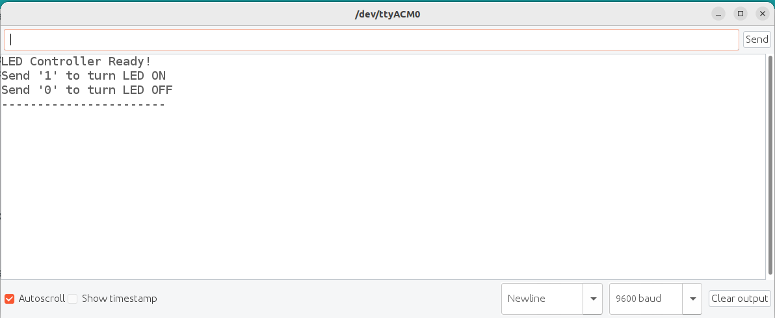
UART Code Example (Arduino to PC)
How to Use:
Upload this code to your Arduino
Open Serial Monitor (Tools → Serial Monitor)
Set baud rate to 9600
Type 1 and click Send to turn LED ON
Type 0 and click Send to turn LED OFF

Slide 45
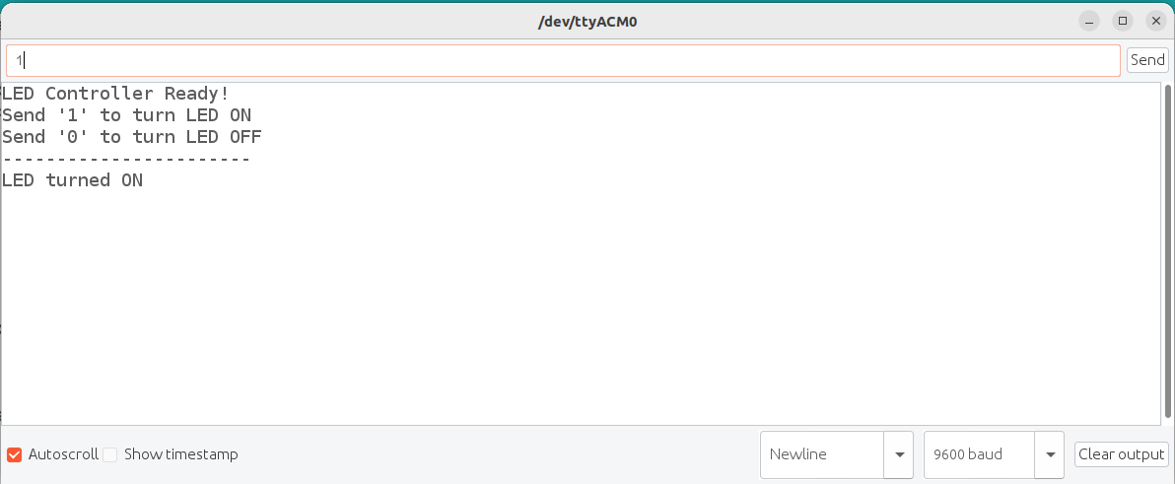
UART Code Example (Arduino to PC)
How to Use:
Upload this code to your Arduino
Open Serial Monitor (Tools → Serial Monitor)
Set baud rate to 9600
Type 1 and click Send to turn LED ON
Type 0 and click Send to turn LED OFF
Pc -> Arduino
Arduino -> Pc

Slide 46
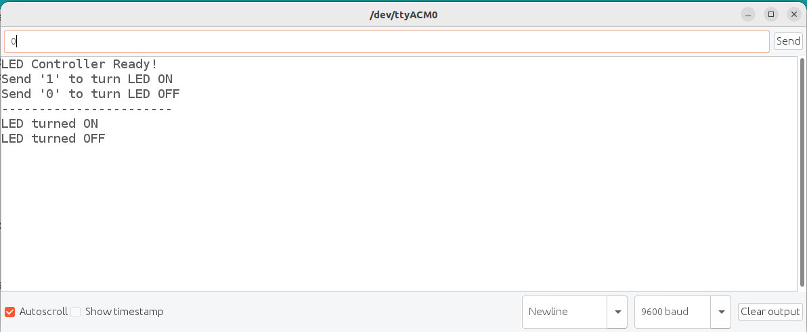
UART Code Example (Arduino to PC)
How to Use:
Upload this code to your Arduino
Open Serial Monitor (Tools → Serial Monitor)
Set baud rate to 9600
Type 1 and click Send to turn LED ON
Type 0 and click Send to turn LED OFF
Pc -> Arduino
Arduino -> Pc

Slide 47
Arduino Communication Protocols: I2C
Definition: Inter-Integrated Circuit (I2C) is a synchronous, multi-slave protocol using only two wires.
Key Concepts:
Synchronous: Uses a shared clock signal (SCL).
SDA (Serial Data): The line for actual data transfer.
SCL (Serial Clock): The line for the clock signal.
Master/Slave: One master device controls the communication. Slaves have unique 7-bit addresses.
Pull-up Resistors: Required on both SDA and SCL lines to keep them high.
Advantages:
Only two wires for many devices, simple wiring.
Limitations:
Slower than SPI, address conflicts can occur.

Slide 48
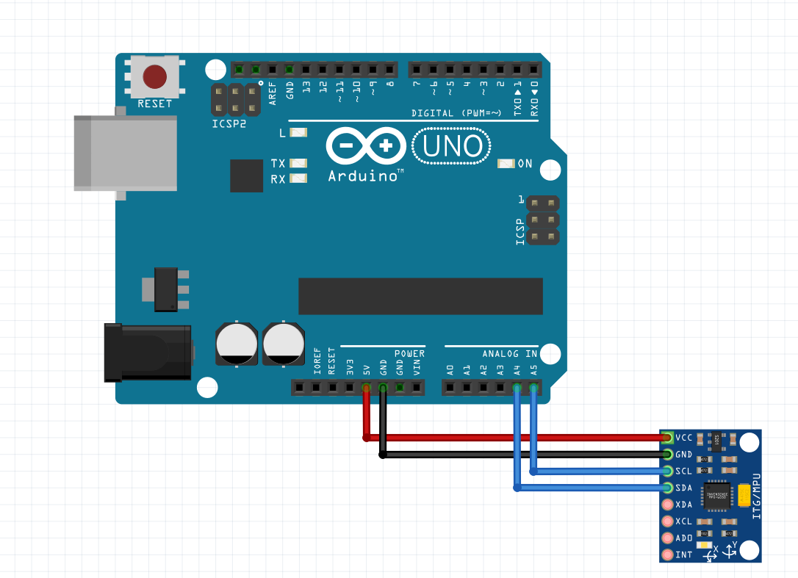
I2C Example
Arduino Uno connected to an MPU-6050 Accelerometer
Arduino GND → MPU-6050 GND
Arduino 5V → MPU-6050 VCC
Arduino A4 (SDA) → MPU-6050 SDA
Arduino A5 (SCL) → MPU-6050 SCL
(Note: Many boards have dedicated SDA/SCL pins)

Slide 49
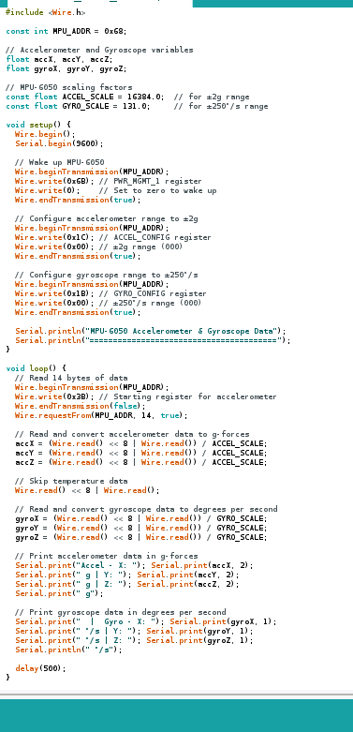
I2C Code Example
Serial Monitor Output Example:
MPU-6050 Accelerometer & Gyroscope Data
========================================
Accel - X: 0.08 g | Y: -0.02 g | Z: 1.02 g | Gyro - X: 1.1 °/s | Y: -0.2 °/s | Z: 0.3 °/s
Accel - X: 0.07 g | Y: -0.01 g | Z: 1.01 g | Gyro - X: 1.0 °/s | Y: -0.1 °/s | Z: 0.4 °/s
Key Improvements:
Proper Scaling:
Accelerometer: Raw values divided by 16384.0 for ±2g range
Gyroscope: Raw values divided by 131.0 for ±250°/s range
Meaningful Units:
Accelerometer: g-forces (1g = gravity)
Gyroscope: degrees per second (°/s)
Sensor Configuration:
Explicitly set accelerometer range to ±2g
Explicitly set gyroscope range to ±250°/s
Realistic Values:
At rest, Z-axis accelerometer should show ~1g (gravity)
Gyroscope values should be near 0 when not rotating

Slide 50
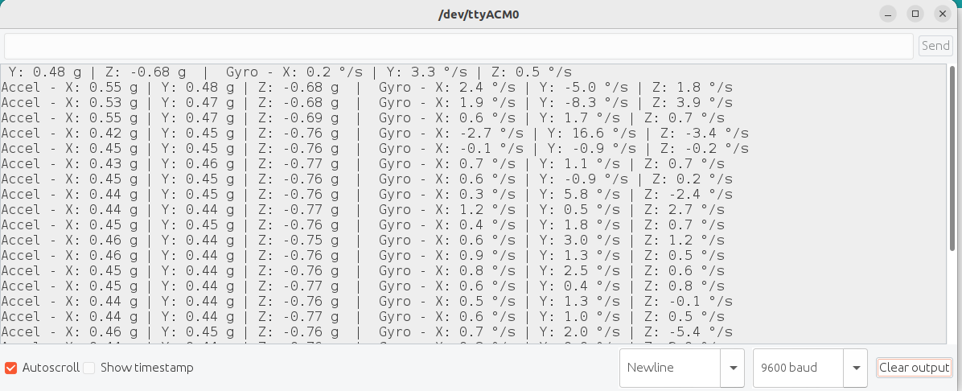
I2C Code Example

Slide 51
Arduino Communication Protocols: SPI
Definition: Serial Peripheral Interface (SPI) is a synchronous, full-duplex protocol known for its high speed.
Key Concepts:
MOSI (Master Out Slave In): Data from Master to Slave.
MISO (Master In Slave Out): Data from Slave to Master.
SCK (Serial Clock): Clock signal generated by the Master.
SS/CS (Slave Select/Chip Select): Activated by Master to choose which slave to talk to.
Full-Duplex: Data can be sent and received simultaneously.
Advantages:
Very fast, flexible data size, simple hardware.
Limitations:
Uses more wires (4 per device), more pins needed for multiple slaves.

Slide 52
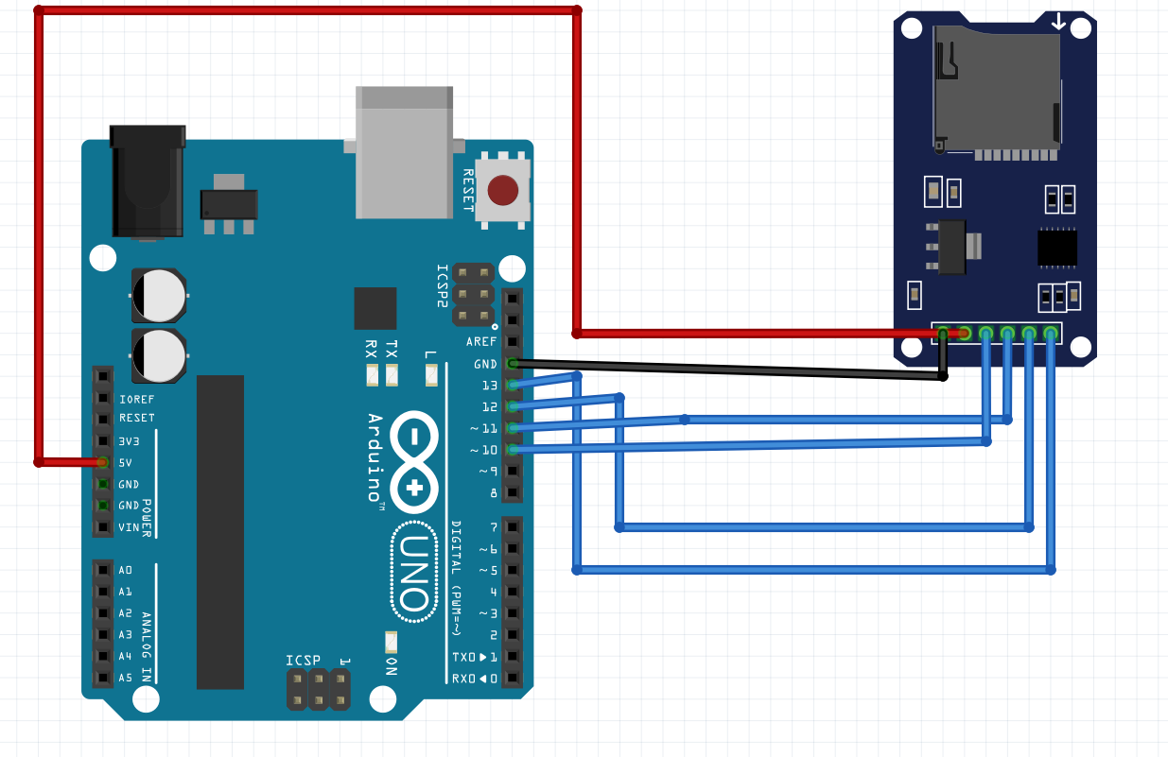
Arduino Uno connected to an SD Card Module
Arduino GND → Module GND
Arduino 5V → Module VCC
Arduino Pin 13 (SCK) → Module SCK
Arduino Pin 12 (MISO) → Module MISO
Arduino Pin 11 (MOSI) → Module MOSI
Arduino Pin 10 (SS) → Module CS

Slide 53
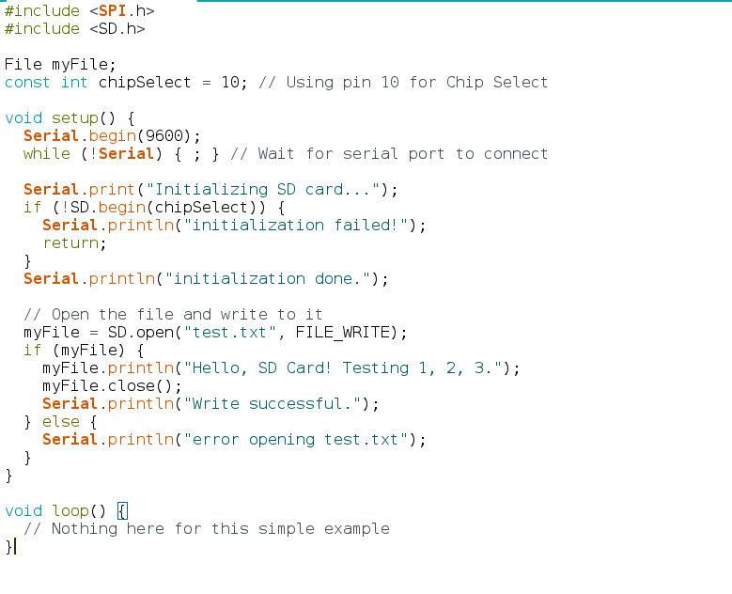
Arduino Uno connected to an SD Card Module

Slide 54
Protocol Comparison : UART vs I2C vs SPI
Feature | UART | I2C | SPI
Wires (ex. Power) | 2 (TX, RX) | 2 (SDA, SCL) | 4 (MOSI, MISO, SCK, SS)
Speed | Slow to Medium | Medium | Very Fast
Synchronization | Asynchronous | Synchronous | Synchronous
Topology | Point-to-Point | Multi-Slave Bus | Multi-Slave (with separate SS)
Complexity | Low | Medium | Medium (Hardware) / Low (Software)
Typical Use Cases | GPS, Bluetooth, Serial Monitor | Sensors (Temp, Accel), RTC, EEPROM | SD Cards, TFT Displays, High-Speed ADC

Slide 55
Real-World Use Cases
Which Protocol Should You Use?
UART:
When: You need simple, direct communication between two devices.
Examples: GPS modules, Bluetooth/Wi-Fi modules, outputting debug data to the Serial Monitor.
I2C:
When: You need to connect many devices using minimal wires, and speed is not the top priority.
Examples: Temperature sensors (BME280), accelerometers (MPU6050), real-time clocks (RTC), small OLED displays.
SPI:
When: You need the highest possible data transfer speed.
Examples: SD/MicroSD card modules, TFT/OLED displays with high refresh rates, digital audio chips.

Slide 56
UART
A0 14
A1 15
A2 16
A3 17
A4 18
A5 19
analogWrite()
digitalRead()
digitalWrite()
analogRead()
digitalRead()
digitalWrite()
UART
I2C

Slide 57
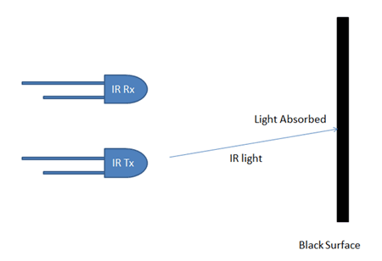
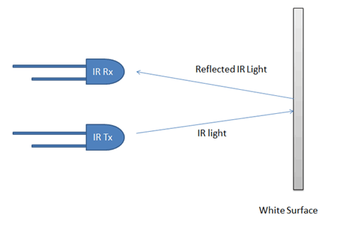
InfraRed Sensor

Slide 58
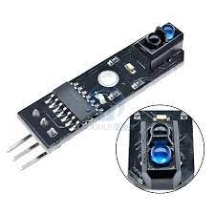
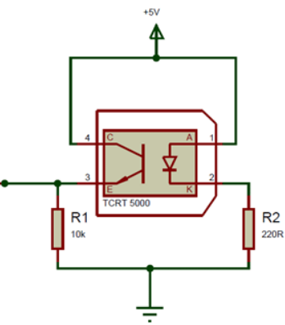
Example of infraRed Sensor : TCRT5000
arduino
5v
GPIO
GND

Slide 59
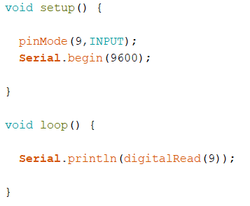
TCRT5000 TEST

Slide 60
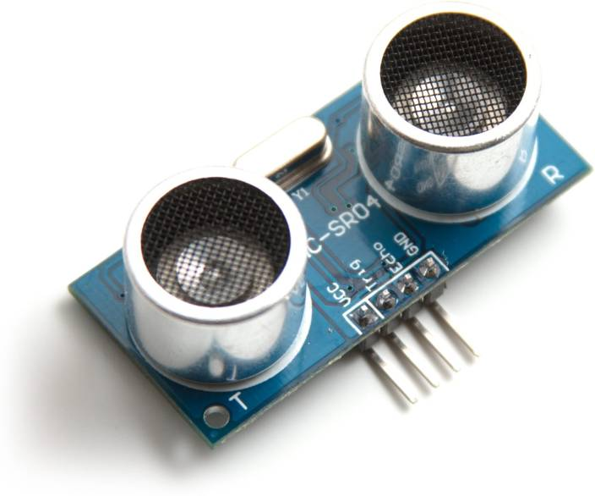
Ultrasonic sensor
Receiver
Transmitter
GND
Echo
Trig
VCC

Slide 61
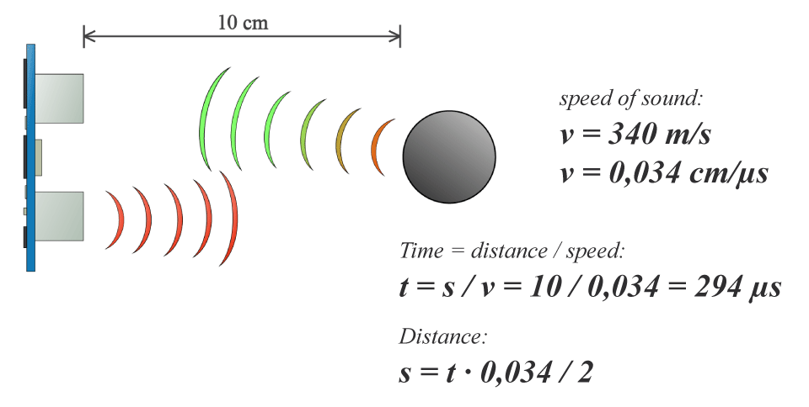
Ultrasonic sensor

Slide 62

Ultrasonic sensor

Slide 63

Ultrasonic sensor test

Slide 64

L298N Dual H-Bridge Motor Driverr
Le module L298N est une carte de développement basé sur le circuit intégré L298N permettant le pilotage de moteur à courant continu ou d’un moteur pas-à-pas.

Slide 65

Principe de fonctionnement

Slide 66



Principe de fonctionnement
IN1 IN3 | IN2 IN4
0 | 0
1 | 0
0 | 1
1 | 1

Slide 67


L298N test

Slide 68

exercice
Make a program that turns the motor in one direction and then turns in our direction every 2 seconds

Slide 69


Control with speed variation

Slide 70

exercice
Make a program that turns the motor in one direction with a speed 100 then turns in other direction with a speed 150 each 2 seconds

Slide 71

line follower: component

Slide 72

Différent mouvement
Ar()
Av()
d()
g()

Slide 73


Exemple 1
Make av()

Slide 74

Exemple 2
Make d()

Slide 75

problème
Make a program that makes a robot: av,d,ar,g,d,ar……..

Slide 76

solution

Slide 77

Use Arduino function

Slide 78

exemple

Slide 79




Methodology to make a line follower code
C1 | C2
0 | 0
0 | 1
1 | 0
1 | 1
av
g
g
av

Slide 80

code body
define pin
Configuration de pin
Read sensor
Code robot
Créer les fonction

